Slide 1
WAES1102
Introduction to Natural Language Processing
By
Dr. Rohana Mahmud
( rmana@um.edu.my / rmhana1@yahoo.com )

Slide 2
Natural Language Processing
Natural language processing is a branch of AI whose goal is to facilitate communication between humans and computers using written (monologue) or oral (dialogue) of the human language
Natural language processing consist of two main areas :
  Natural language understanding :
    to make computers understand instruction given in natural language
  Natural language generation :
    to make computers generate natural language

Slide 3
Study of Language
Language:
  Written: Long-term record of knowledge from one generation to another
  Spoken: primary mean of coordinating day-to-day behavior with others
  Natural (eg. Malay, English) vs. Artificial (Java, Prolog, Coding)
Communication
  Use sign / natural language/ body language / music
  Sender and Receiver @ Speaker & Hearer @ Writer & Reader
  Monolog (1 way) or Dialog (2 ways) : Written Text & Speech

Slide 4
Study of Language
Studied in several disciplines:
  Linguist: structure of language
  PsychoLinguists: the process of human language production and comprehension
  Philosopher: how words can mean anything & how they identify object in the world, what it means to have belief, goals and intention, cognitive capabilities relate to language
  CL / NLP: to develop a computational theory of Language (using the notions of algorithm & data structure from CS)

Slide 5
ELIZA system
Mid-1960s, MIT, a Therapist (system) & patient (user), Weizenbaum, 1966
Algorithm:
  Has a Dbase of particular words (keywords)
  For each keyword -> store an integer, a pattern to match against the input and a specification of the output
  Given Sentence(S), find a keyword in S whose pattern matches S
  If > 1 keyword, pick the one with highest integer value
  Use the output specification that is associated with this keyword to generate next sentence
  If there are No keywords, generate an innocuous continuation statement, eg: Tell me more, Go on. (figure 1.2, 1.3 Allen)

Slide 6
Flow of Language Analysis
Natural language understanding follows the following stages
  Parsing
    Involves the analysis of the syntactic structure of sentences. Parsing determines that a sentence follows the syntactic rules of the language. The output of the parsing stage is a parse tree
  Semantic interpretation
    Involves the production of a representation (propositions, conceptual graphs, frames) of the meaning of a sentence
  Incorporation of world knowledge
    Involves the generation of an expanded representation of the sentence’s meaning for the complete understanding of the sentence
The output produced could then be used by application systems such as the database query handler, expert system interface, translator and HCI systems.

Slide 7
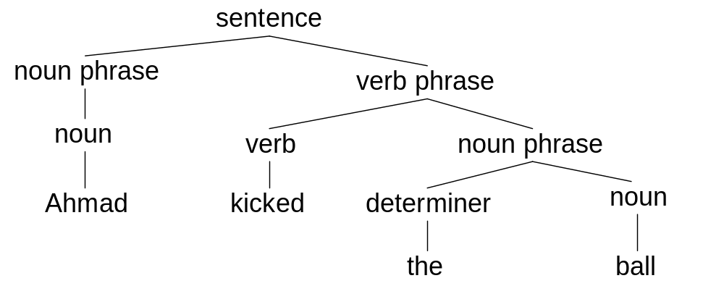
Flow of Language Analysis
Parsing
Sentence : Ahmad kicked the ball

Slide 8
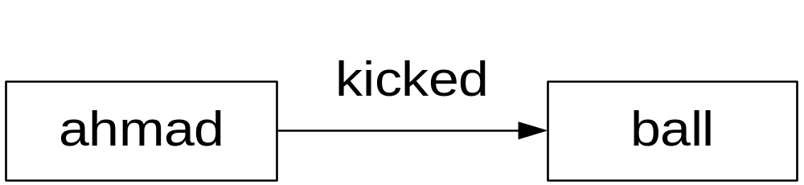
Stages of Language Analysis
2. Semantic Interpretation
Eg. Sentence : Ahmad kicked the ball

Slide 9
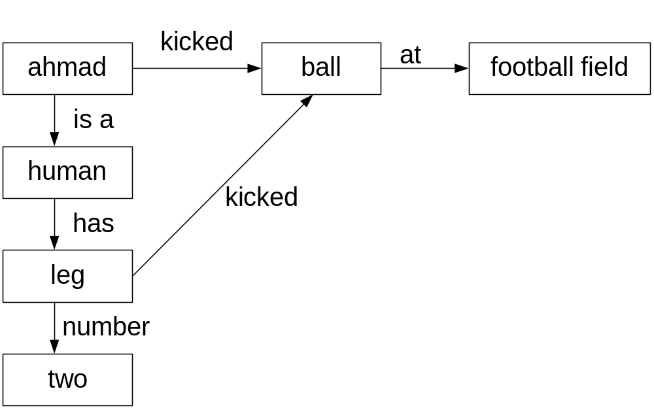
Flow of Language Analysis
3. Incorporation of World Knowledge
Sentence : Ahmad kicked the ball

Slide 10
The Different Levels of Language Analysis
Phonetics/phonology Knowledge (K)- how words are related to the sounds that realize them
Morphology K– how words are constructed from more basic meaning units called morpheme, the primitive unit of meaning in a language
Syntactic K– how words can be put together to form correct sentences and determines what structural role each word plays in the sentence and what phrases are subparts (eg. POS) of what other phrases

Slide 11
Levels of Language Analysis cont.
Semantic K– what words mean (lexical semantics) and how these meanings combine in sentences to form larger meaning, eg. sentence meanings (compositional semantic). Study of context-independent meaning
Pragmatic K – concern how sentences are used in different situations and how use affects the interpretation of the sentence (kind of polite and indirect language); Context-dependent meaning.
Discourse K- how the immediately preceding sentences affect the interpretation of the next sentence. (pronoun and temporal aspects of information conveyed)
World K – includes the general knowledge about the structure of the world that language users must have in order to eg. Maintain a conversation. Includes what each language user must know about the other user’s beliefs and goals (discourse model)

Slide 12
Morphological Analysis
The construction of words from more basic components
Large vocabulary system has a problem in representing lexicon
Reasons:
  A large number of words. Word can be formed in 2 ways:
    Inflectional form : go+es/ne = goes/gone (v -> v)
    Derivational form : friend + ly = friendly (n -> adj)
  Open Class words (noun, verb, adj, adv) & Closed class words (articles, pronouns, prepositions)

Slide 13
One Solution
Preprocess the input sentence into a sequence of morphemes
A word may consist of a single morpheme, but often a word consists of a root form plus an affix

Slide 14
Example
The word: goes
  Root word : go
  Suffix : es (plural, present tense)
  Without pre-processing, a lexicon needs to list all the form of go, including: went, going, gone
  With preprocessing, there would be ONE morpheme go that may combine with suffixes such as –ing, -es, and –en; and ONE entry for the irregular form: went. Thus, the lexicon would only need to store TWO entries (go and went) rather than FOUR.
Other examples: eaten, happiest
Some word cannot be decomposed into a root form and a suffix. Example is the word seed

Slide 15
Finite State Transducer (FST)
A lexicon would have to encode what forms are allowed with each root
One famous model is based on FSTs
This model is like the Finite State Machines except that they produce an output given an input

Slide 16
FST cont.
An arc is labeled with a pair of symbols
For eg:
  An arc labeled i:y ; could only be followed if the current input is the letter i and the output is the letter y
FST can be used to concisely represents the lexicon and to transform the surface form of words into a sequence of morphemes.
Show examples in Allen, pg 71-72

Slide 17
FST cont.
Arcs labeled by a single letter have that letter as both input and output
FST accepts the appropriate forms and outputs the desired sequence of morphemes
The entire lexicon can be encoded as an FST that encodes all the legal words and transforms them into morphemic sequences
The different suffixes need only be defined once, and all root forms that allow that suffix can point to the same node

Slide 18
Syntactic Analysis
Syntactic analysis involves analyzing the structure of a sentence. This would require checking whether the sentence is formed according to a set of syntactic rules – grammar
Parsing is an activity that takes a sentence as a set of linguistic token (words) and checks the ordering of the tokens against a grammar. If the sentence is derived from the grammar then parsing yields a parse tree of the sentence

Slide 19
Parsing using context free grammars
A context free grammar comprises rules that are made up of two types of symbols – terminals and non terminals
Non – terminals
  Terms that describe higher-level linguistic concepts such as sentence, noun phrase verb phase. Non terminals need to be further expanded as they may contain other non terminals and terminals
Terminals
  Terms that are usually individual words. Terminals cannot be further expanded. They never appear on the right of a rule

Slide 20
Parsing using context free grammars
Parsing of a sentence begins with the non-terminals symbol sentence at the top of the parse tree
Parsing progresses by way of substitutions according to the rules of the grammar.
A legal substitution replaces the left-side of a rule with the non-terminal (and terminal) symbols of the right side of the rule. In this case, higher level non-terminal symbols are replaces by lower level non-terminal symbols or terminals.
Parsing is terminated when all the lower nodes of the parse tree comprise terminals, i.e. individual words.
If the order of the terminals in the parse tree is the same as that of the original sentence when it is said the sentence follows the rules of the language, i.e. is a legal sentence

Slide 21
Parsing a Natural Language Sentence
Consider the grammar :
  sentence -> noun_phrase verb_phrase
  noun_phrase -> noun
  noun_phrase -> article noun
  verb_phrase -> verb
  verb_phrase -> verb noun_phrase
  article -> the
  article -> a
  noun -> man
  noun ->car
  verb -> drove

Slide 22
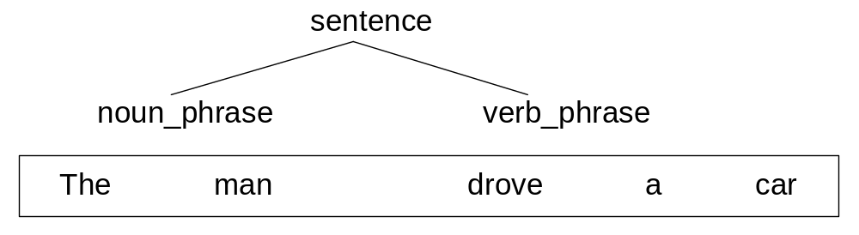
Step 1
The man drove a car

Slide 23
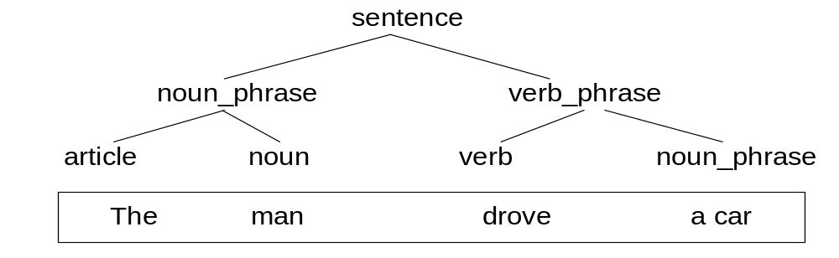
Step 2
The man drove a car

Slide 24
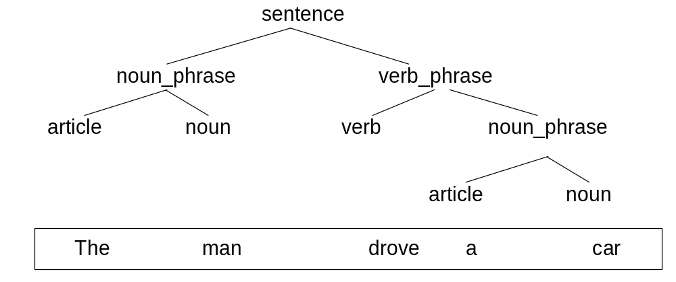
Step 3
The man drove a car

Slide 25
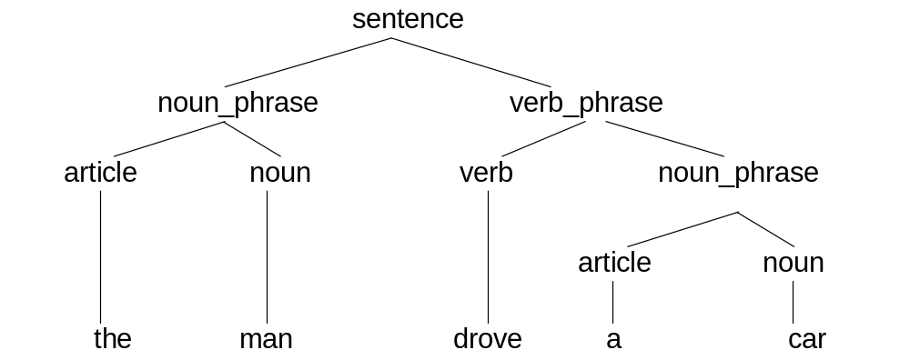
Step 4
The man drove a car

Slide 26
Parsing a Natural Language Sentence
Derivation of the sentence “the man drove a car” according to the given grammar
STRING | APPLY RULE #
1. sentence | 1
2. noun_phrase verb_phrase | 3
3. article noun verb_phrase | 5
4. article noun verb noun_phrase | 3
5. article noun verb article noun | 6
6. the noun verb article noun | 8
7. the man verb article noun | 10
8. the man drove article noun | 7
9. the man drove the noun | 9
9. the man drove the car | Sentence parsed

Slide 27
Representation & Understanding
A crucial component of understanding involves computing a representation of the meaning of sentences and texts. (Reason: Senses & ambiguity)

Slide 28
Representations and Understanding
Computing a representation of the meaning of sentences and texts (Notion of representation)
Why can’t use the sentence itself as a representation of its meaning? Most words have multiple meanings (Senses). eg. Cook, bank, still (verb or noun),
  I made her duck.
  I saw a man in the park with a telescope
Thus, ambiguity inhibit system from making the appropriate inferences needed to model understanding (need to resolve or disambiguate: eg. Use Lexical disambiguation: POS, word-sense disambiguation, ontology)
A program must explicitly consider each senses of a word to understand a sentence

Slide 29
Represent meaning: must have a more precise language
Mathematics & Logic and the use of formally specified representation languages (formal language) – notion of an atomic symbol
Useful representation languages have 2 properties:
  Precise and unambiguous
  Capture the intuitive structure of the natural language sentences that it represents

Slide 30
Representation
Syntax – indicates the way that words in the sentence are related to each other
The structure illustrates how the words are grouped together into phrases, what words modify what other words and what words are of central importance in the sentence
It may identify the types relationships that exist between phrases and can store information about the particular sentence structure that may be needed for later processing
Eg: 1. John sold the book to Mary
2. The book was sold to Mary by John

Slide 31
Representation cont.
Sentence Structure does not reflect its meaning (although have the same syntactic structure, eg. the catch)
The intended meaning of a sentence depends on the situation in which the sentence is produced.
Context independent (the logical form,LF) vs. Context dependent

Slide 32
Semantic Analysis:
The Logical Form, LF
LF = encodes possible word senses and identifies the semantic relationships between the words and phrases
Many of the relationships are captured using an abstract set of semantic relationships between the verb and its NP
Context Independent
Eg: Selling event, John is the seller, the book is the object being sold and Mary is the buyer.
These roles are instances of the abstract semantic roles: AGENT, THEME and TO-POSS (final possessor), respectively.
Show another example: invite - the ball

Slide 33
The Final Meaning Representation
The final representation: a general Knowledge Representations language, which is the system uses to represent and reason about its application domain
The goal of contextual interpretation is to take a representation of the structure of a sentence and its logical form, and to map this into some expression in the KR that allow the system to perform the appropriate task in the domain.
This is the language in which all the specific knowledge based on the application is represented
Use FOPC, Semantic Network
Eg: Q-A application – a Q might map to a DB; Story Understanding application – a sentence might map into a set of expressions that represent the situation that the sentence describes.

Slide 34
Discourse & Pragmatic Analysis
Context Dependent
Discourse Structure Theory
  Discourse Relations
  Discourse Model
  Discourse Structure
World Knowledge
  Domain Specific
  Corpus

Slide 35
Applications
Story teller (Tutoring System)
Information Extraction
Summarization
Essay Grader System
Search engine
HCI

Slide 36
Application of NLU
Dialogue-based applications – involve human-machine communication (spoken / keyboard/mouse/ recognizer)
  Q&A systems, eg. Query database
  Automated customer service (phone)
  Tutoring systems (interaction with students)
  Spoken language control of machine
  General cooperative problem-solving system
Speech recognition <> Language understanding system (only identify the word spoken from a given speech signal, not – how words are used to communicate)
Discuss ELIZA system

Slide 37
Application of NLU
It represents the meaning of sentences in some representation language that can be used later for further processing : applications
Text-based applications
  Written text processing (books,newpaper, reports, manual, email, sms) = reading-based tasks
    Searching/finding from database of text
    Extracting information from text
    Translating documents (MT)
    Summarizing texts for certain purpose
    Story understanding

Slide 38
Discussion
Use the following sentences to understand (to describes) the distinction between syntax, semantics and pragmatics:
  Language is one of the fundamental aspects of human behavior and is a crucial component of our lives.
  Green frogs have large noses.
  Green ideas have large noses.
  Large have green ideas noses.

Slide 39
Discuss the following sentences (ambiguity)
1. I made her duck. (4/5 meanings)
2. I saw a man in the park with a telescope. (2 meanings)
Make your own ambiguous sentences

Slide 40
Bibliography
ACL (Association for CL) / EACL
COLING (int conference of CL)
Applied NLP
Workshop on Human Language Technology
Journal: CL & NLE
IEEE ICASSP: Acoustic, Speech and Signal Processing
IEEE Transactions on Pattern Analysis and Machine Intelligence
IJCAI: Int Joint Conference on AI
Journal: AI, Computational Intelligence, Cognitive Science

